Slide 1
Differentiation-Discrete Functions
by
Dr. Md. Rajibul Islam
CSE, UAP

Slide 2
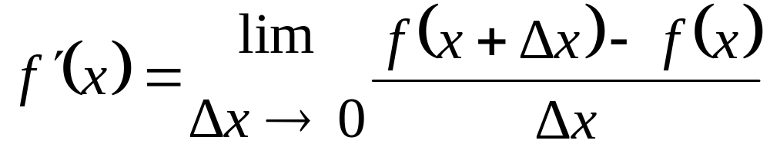

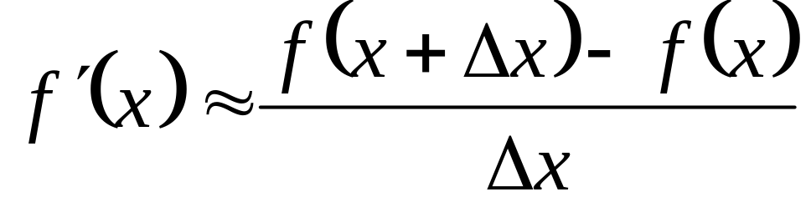
Forward Difference Approximation
For a finite

Slide 3
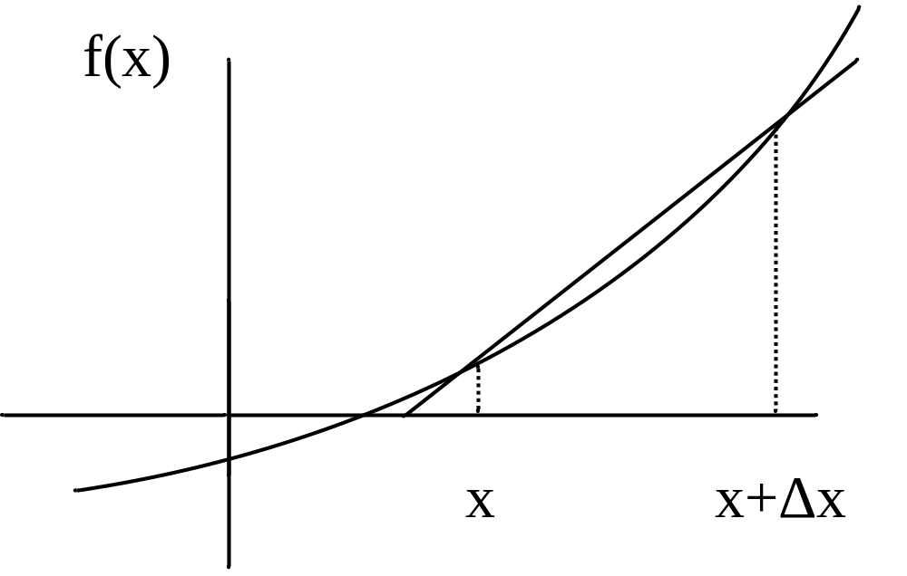
Graphical Representation Of Forward Difference Approximation
Figure 1 Graphical Representation of forward difference approximation of first derivative.

Slide 4

Example 1
The upward velocity of a rocket is given as a function of time in Table 1.
Table 1 Velocity as a function of time
t | v(t)
s | m/s
0 | 0
10 | 227.04
15 | 362.78
20 | 517.35
22.5 | 602.97
30 | 901.67
Using forward divided difference, find the acceleration of the rocket at .

Slide 5



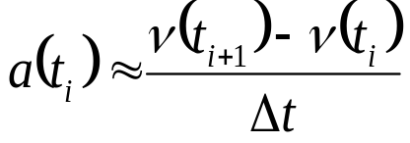


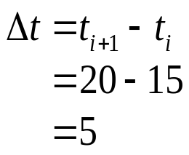
Example 1 Cont.
Solution
To find the acceleration at , we need to choose the two values closest to , that also bracket to evaluate it. The two points are and .

Slide 6
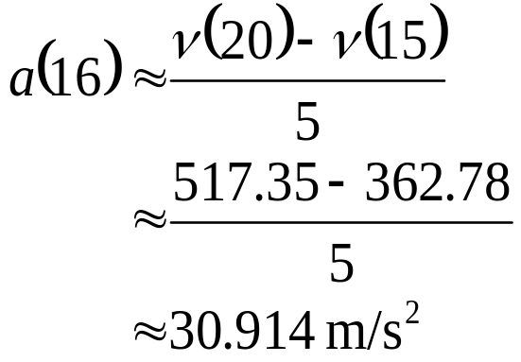
Example 1 Cont.

Slide 7



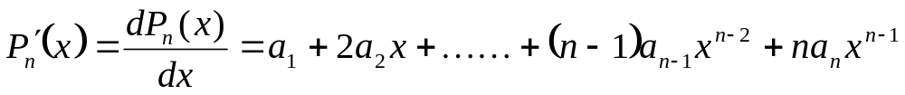
Direct Fit Polynomials
In this method, given
data points
one can fit a
order polynomial given by
To find the first derivative,
Similarly other derivatives can be found.

Slide 8

Example 2-Direct Fit Polynomials
The upward velocity of a rocket is given as a function of time in Table 2.
Table 2 Velocity as a function of time
t | v(t)
s | m/s
0 | 0
10 | 227.04
15 | 362.78
20 | 517.35
22.5 | 602.97
30 | 901.67
Using the third order polynomial interpolant for velocity, find the acceleration of the rocket at .

Slide 9





Example 2-Direct Fit Polynomials cont.
Solution
For the third order polynomial (also called cubic interpolation), we choose the velocity given by
Since we want to find the velocity at , and we are using third order polynomial, we need to choose the four points closest to and that also bracket to evaluate it.
The four points are

Slide 10
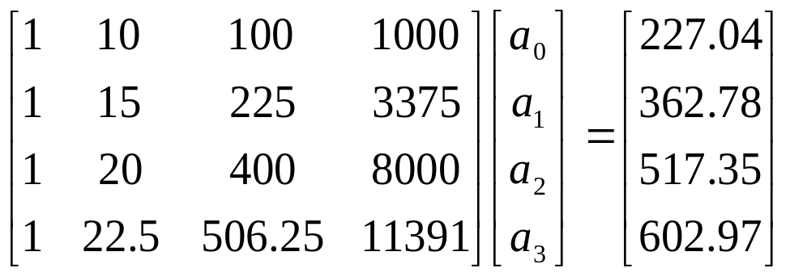
Example 2-Direct Fit Polynomials cont.
such that
Writing the four equations in matrix form, we have

Slide 11




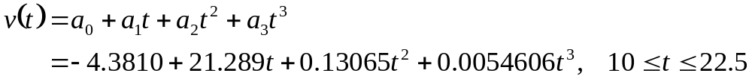
Example 2-Direct Fit Polynomials cont.
Solving the above four equations gives
Hence

Slide 12
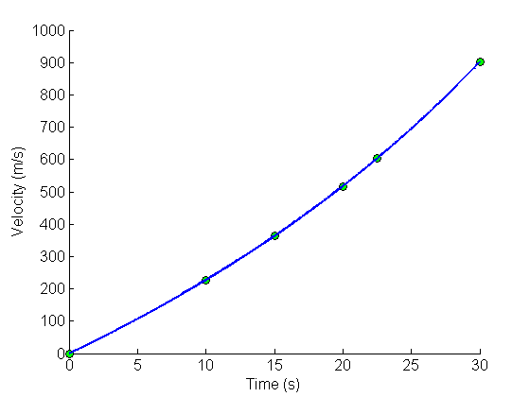
Example 2-Direct Fit Polynomials cont.
Figure 1 Graph of upward velocity of the rocket vs. time.

Slide 13
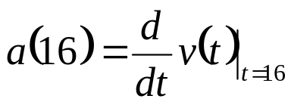
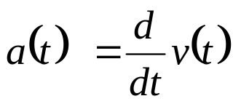
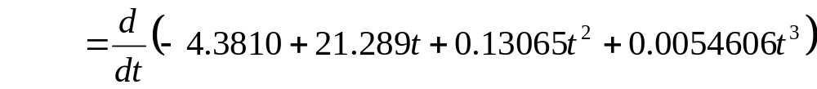

Example 2-Direct Fit Polynomials cont.
,
The acceleration at t=16 is given by
Given that

Slide 14


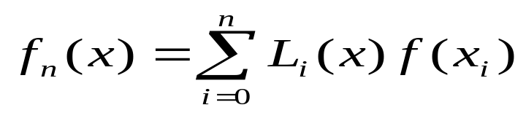




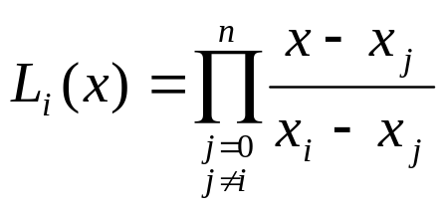



Lagrange Polynomial
In this method, given
, one can fit a
order Lagrangian polynomial
given by
where ‘
’ in
stands for the
order polynomial that approximates the function
given at
data points as
, and
a weighting function that includes a product of
terms with terms of
omitted.

Slide 15


Lagrange Polynomial Cont.
Then to find the first derivative, one can differentiate
once, and so on
for other derivatives.
For example, the second order Lagrange polynomial passing through
is
Differentiating equation (2) gives

Slide 16
Lagrange Polynomial Cont.
Differentiating again would give the second derivative as

Slide 17
Example 3
The upward velocity of a rocket is given as a function of time in Table 3.
Table 3 Velocity as a function of time
t | v(t)
s | m/s
0 | 0
10 | 227.04
15 | 362.78
20 | 517.35
22.5 | 602.97
30 | 901.67
Determine the value of the acceleration at using the second order Lagrangian polynomial interpolation for velocity.

Slide 18
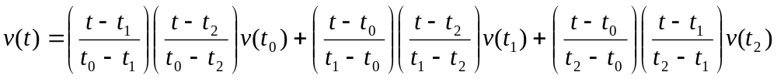
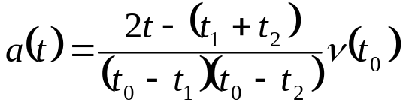
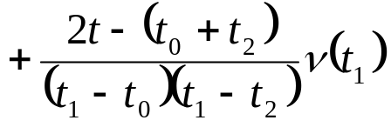
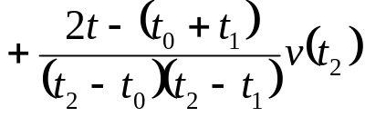
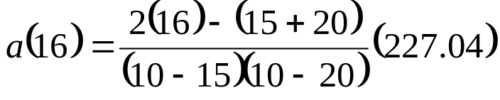
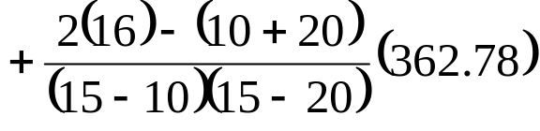
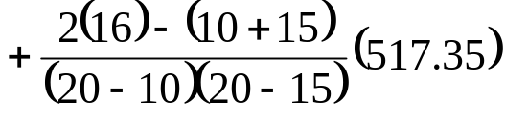

Example 3 Cont.
Solution

Slide 19
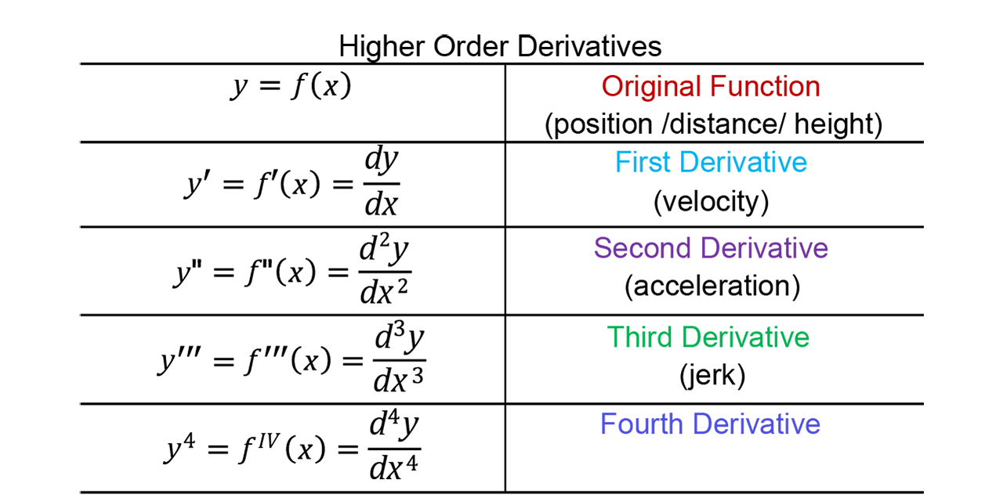
Example 3 Cont.
Note: Based on the question (physics perspective), it’s better
to know the following,

Slide 20
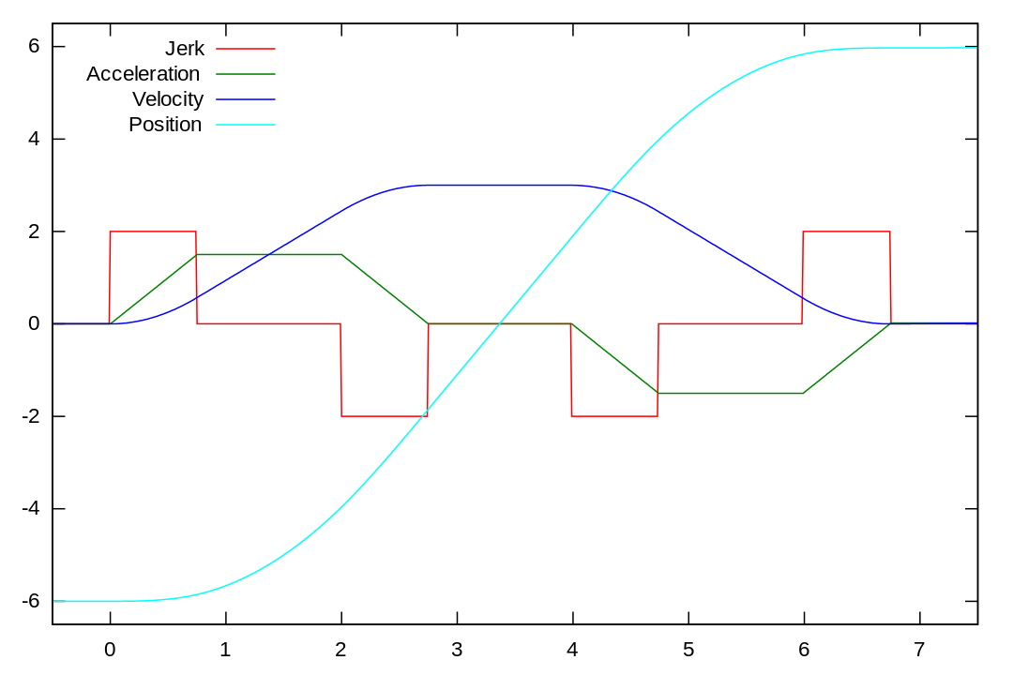
Example 3 Cont.
Note: Based on the question (physics perspective), it’s better to know the following,

Slide 21
THE END

